Slide 1
Extending the Quotes App
Beyond Get and Put, Post and Delete!

Slide 2
Creating a CRUD App
We will need end points for other HTTP Methods
POST
PUT
DELETE
Each end point will be new a corresponding Lambda function

Slide 3
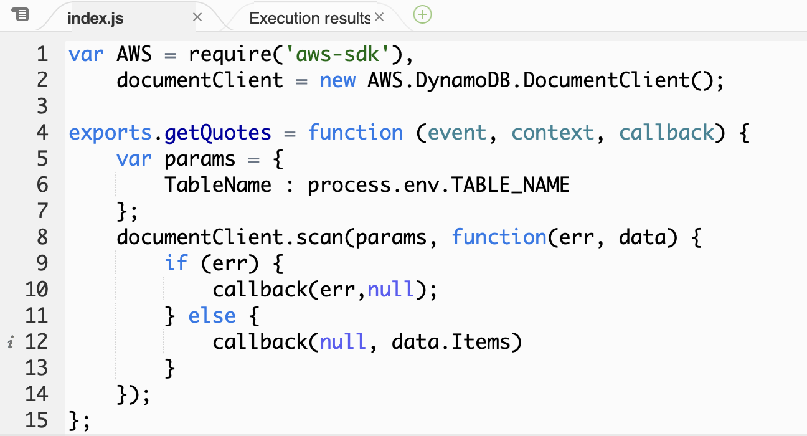
Review GET
Include the AWS SDK
Create a DynamoDB client
Export the lambda function to make visible to external world
Scan the records in the table
Return the Items found
We’ needed’ an Env variable to save the table name

Slide 4
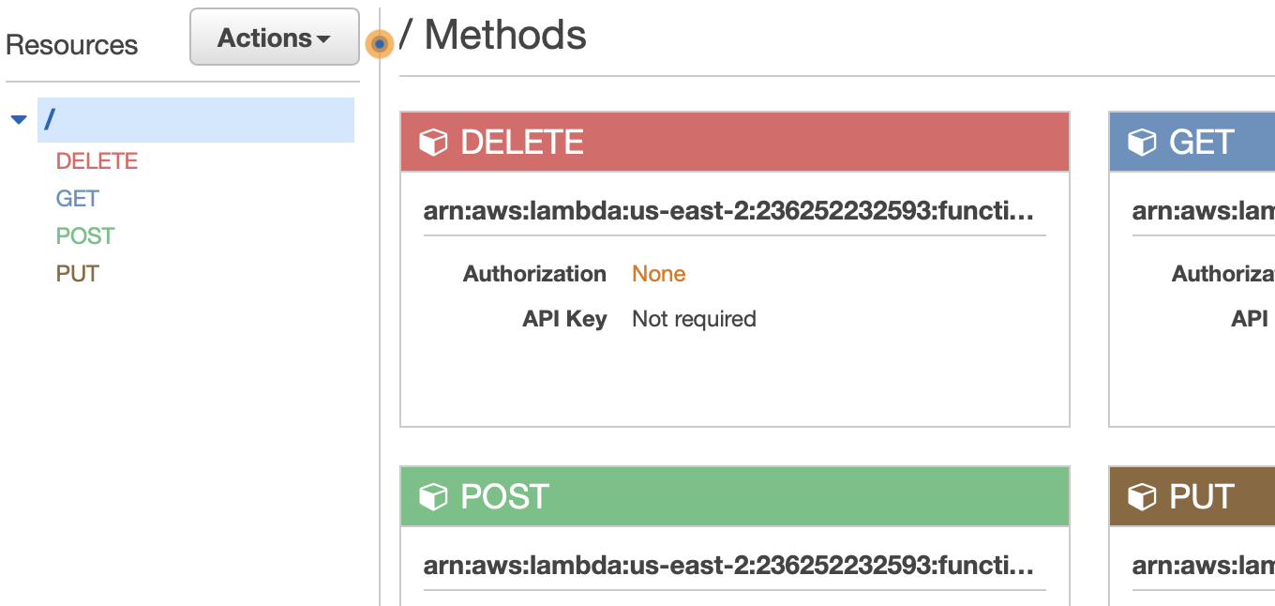
API Gateway
This is a gateway for all things QuotesApi
We will have end points for the other HTTP Methods
POST
PUT
DELETE
You can see I have them all created

Slide 5
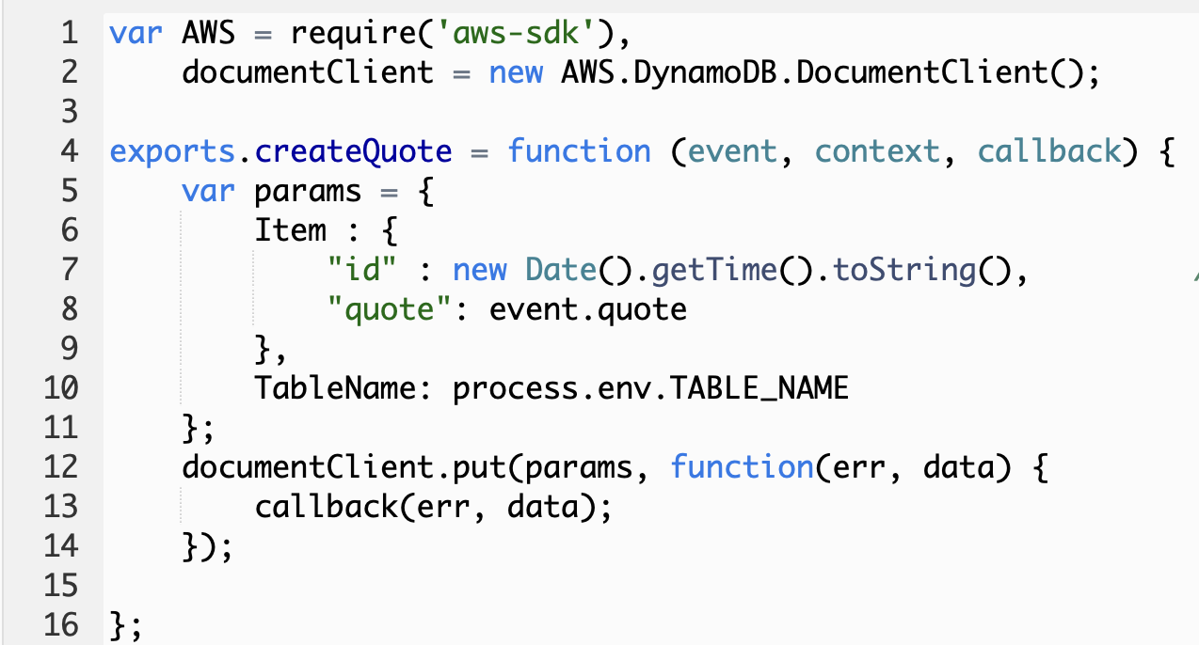
CREATE - Setup
Again compare this to get and delete
Especially the delete function
Identical except of the documentClient function used
put

Slide 6
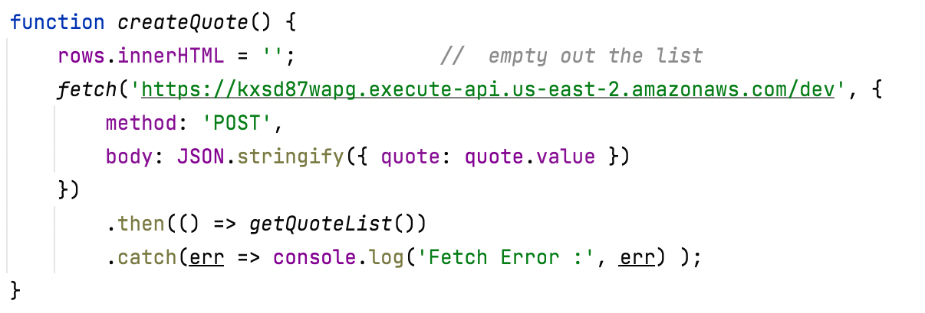
Client-side JS to create a quote

Slide 7
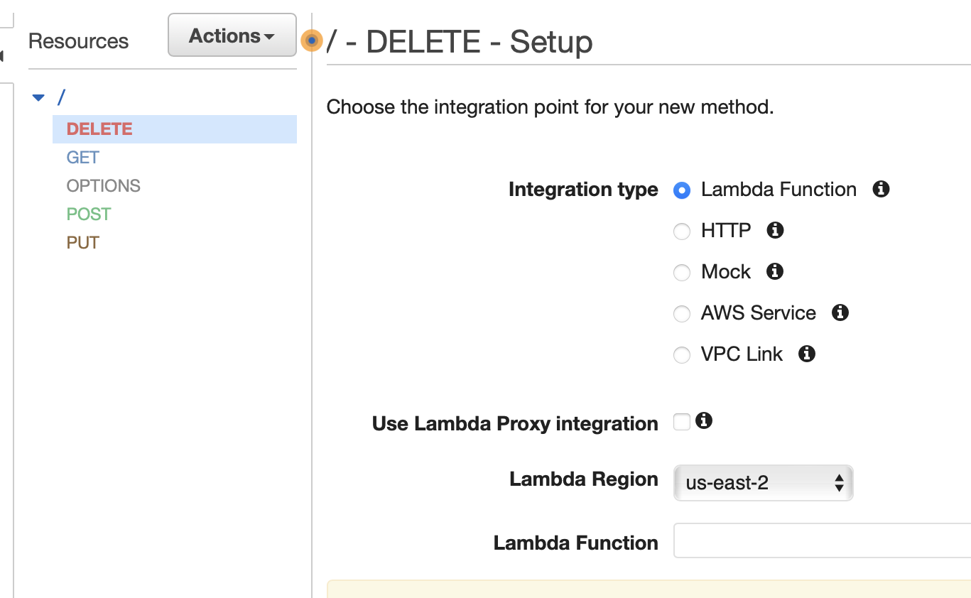
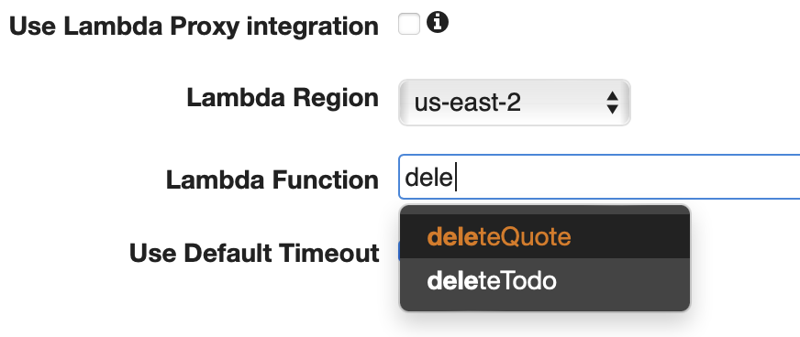
DELETE – Setup
Setup page is shown
In the Lambda Function field start typing dele….
Matching Lambda functions will be displayed
Select deleteQuote
Click Save

Slide 8
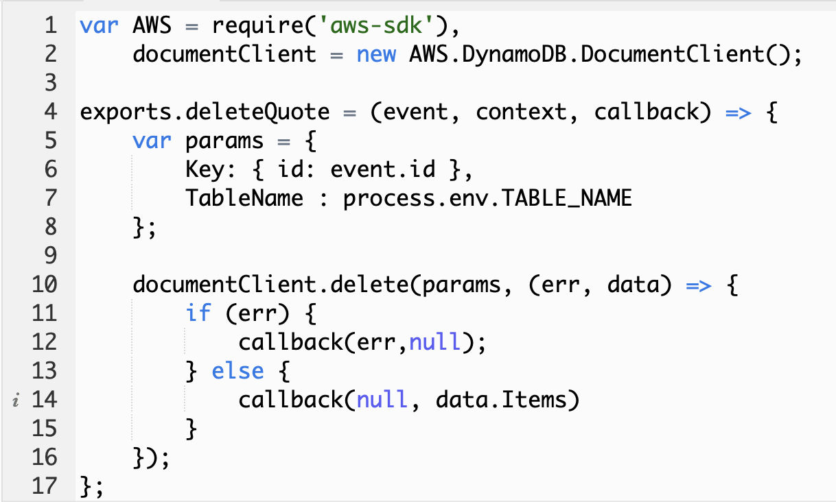
Create deleteQuote
We will do the deleteQuote Lambda function first
If you look back at the getQuote function, you will see that they are nearly identical
The params object now includes the id of the record to be deleted

Slide 9
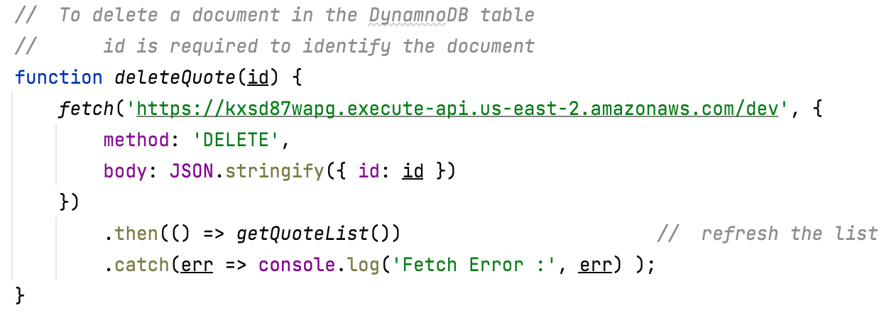
Client-side JS to delete a quote

Slide 10
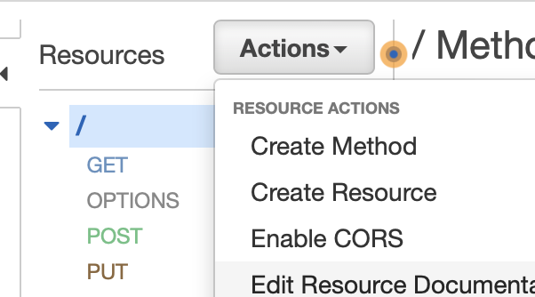
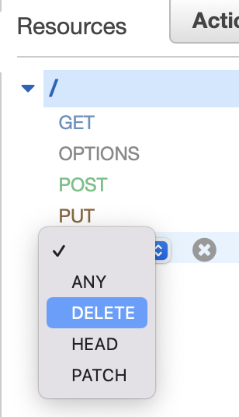
Let’s Create the Delete Method
API Gateway
Add a new method ‘Delete’
There will be a check box next to DELETE after you have selected it
Click on it

Slide 11
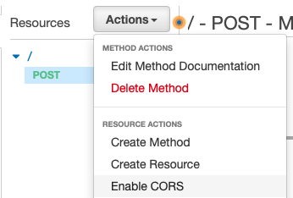
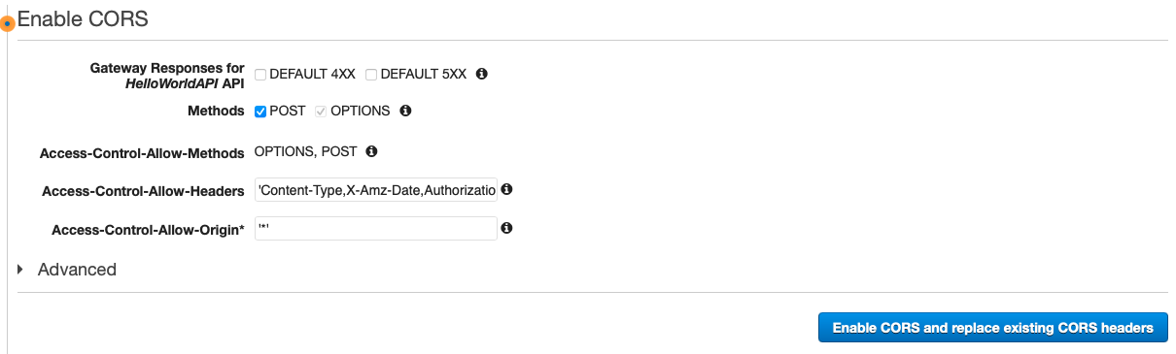
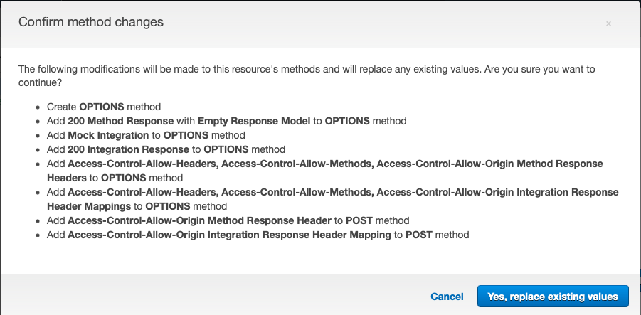
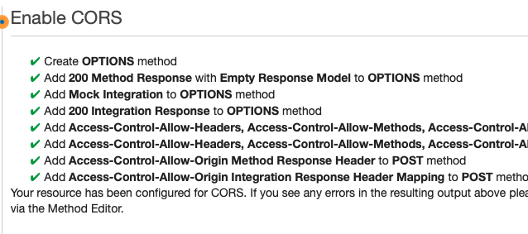
Enable CORS
Actions – Enable CORS
Enable CORS and replace existing CORS headers
Yes, Replace existing values

Slide 12
Wash, Rinse, Repeat
Now do the same for POST and PUT
We will create the Lambda functions
And associate them to new HTTP methods in our APIGateway

Slide 13
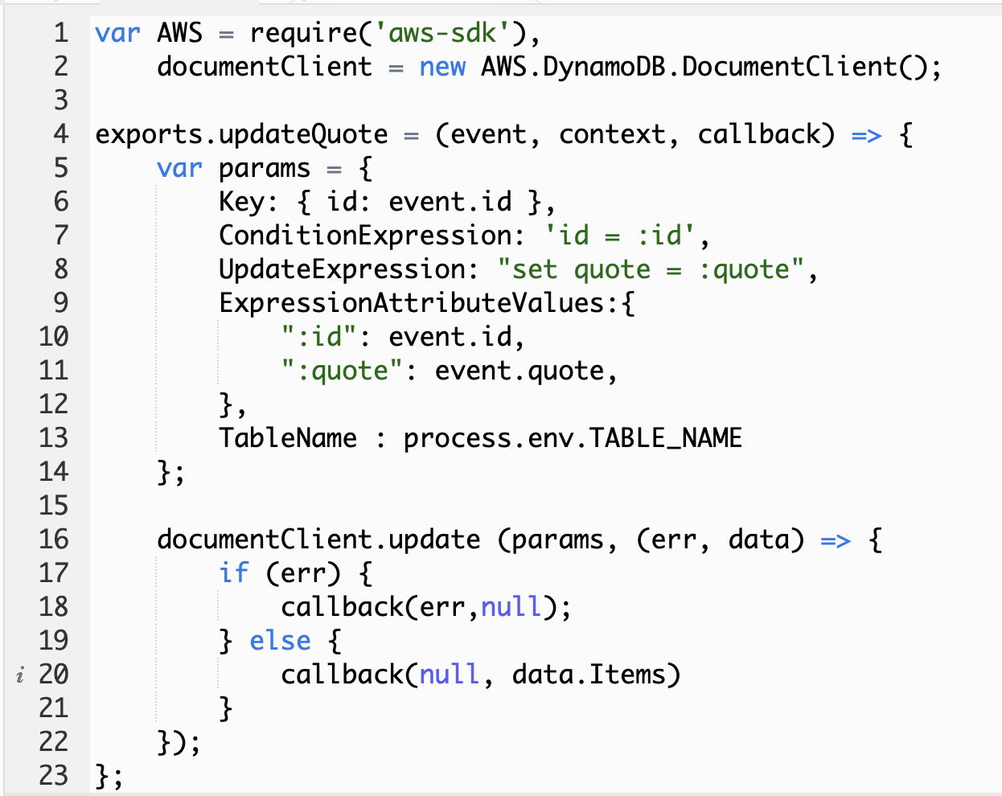
UPDATE – Setup
We get a little more complicated here
With an update we need to identify the record we want changed
See new attributes to the params object

Slide 14
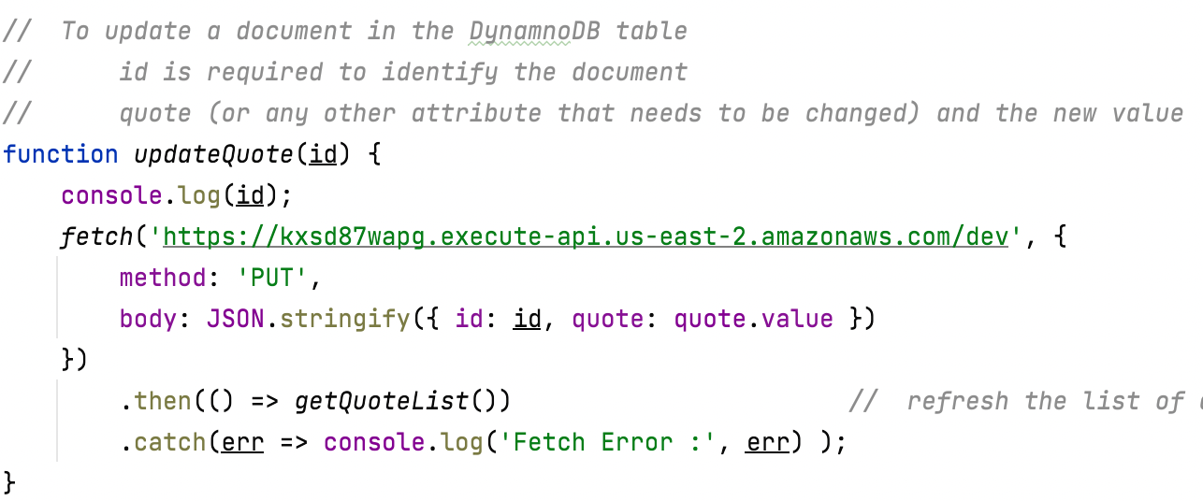
Client-side JS to update a quote

Slide 15
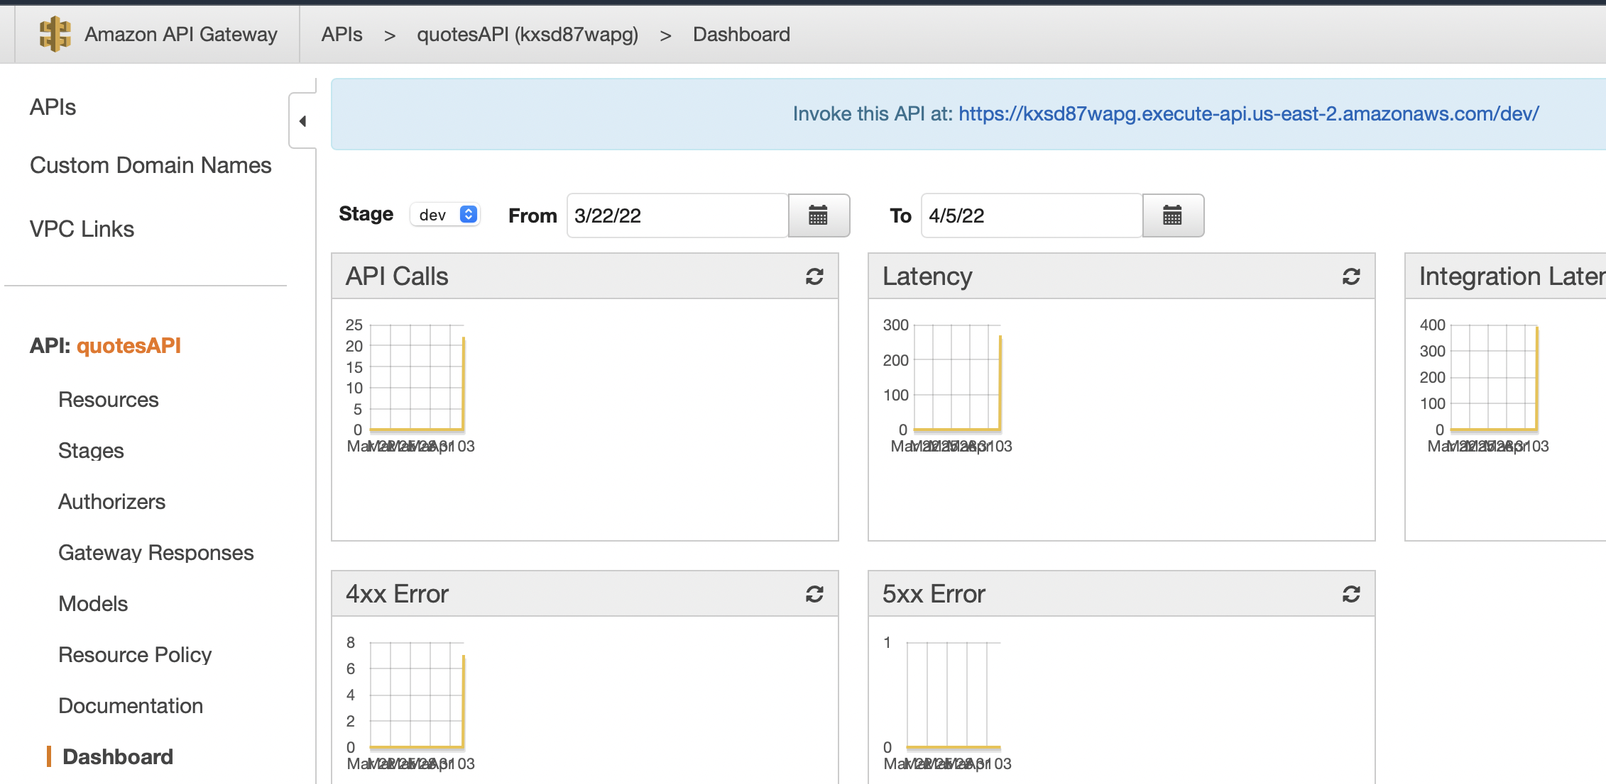
What is the API?
Your client-side JavaScript will need an API path to invoke the new requests
It is the same one used for the GET
You can find it the Dashboard tab of the APIGateway
We will use this in our HTML to GET, POST, PUT and DELETE quotes

Slide 16
App code: client and server side for the CRUD lambda functions
You can find the HTML here
https://gist.github.com/4fcd3eda51175dc44d9d532cffcc4888
There are two files
Quotes.html
Styles.css
Keep them in the same directory
This code will work with MY APIGateway
Change the code to use your own

